Slide 1
P Problems: These are decision problems that can be solved in polynomial time by a deterministic Turing machine. In simpler terms, these are problems for which an algorithm exists that can find a solution efficiently as the size of the input grows. Examples include sorting algorithms like merge sort and searching algorithms like binary search.
NP Problems: These are decision problems for which a proposed solution can be verified in polynomial time. However, finding a solution itself might not be polynomial-time solvable. In other words, if someone gives you a solution, you can quickly check if it's correct. Examples of NP problems include the traveling salesman problem (TSP), the knapsack problem.

Slide 2
The key difference between P and NP problems lies in the efficiency of finding solutions. P problems are considered "easy" in the sense that efficient algorithms exist to solve them. NP problems, on the other hand, are "hard" because while it's easy to verify a solution, finding that solution quickly (in polynomial time) is not guaranteed.
The famous question in theoretical computer science is whether P = NP, i.e., whether every problem whose solution can be quickly verified can also be solved quickly. This question remains unresolved and is one of the seven Millennium Prize Problems, with a million-dollar prize for its solution.

Slide 3
Deterministic Algorithm:
This is like following a recipe step by step.
Every time you run the algorithm with the same inputs, you get the same outputs.
It's predictable and follows a clear, single path to the solution.
Non-deterministic Algorithm:
Imagine you have multiple paths to take in a maze, but you're not sure which is the right one.
Non-deterministic algorithms explore different paths simultaneously.
They can guess potential solutions and check if they work.
These algorithms don't always give the same answer for the same inputs because they might make different guesses each time.
In essence, deterministic algorithms are like following a set plan, while non-deterministic algorithms are more like exploring various options at once and seeing which one works.

Slide 4
one simple example of a nondeterministic algorithm is the "guess and check" method often used in games like "Guess the Number." In this game, instead of systematically trying every possible number one by one (which would be deterministic), you guess a number randomly, and if it's correct, you win; if not, you try another random guess until you get it right. Another example is the "randomized quicksort" algorithm, which uses random choices during partitioning to achieve average-case performance. These algorithms demonstrate nondeterministic behavior because their outcomes can vary based on random choices made during execution.

Slide 5
NP-Hard Problems:
NP-hard problems are those for which no known polynomial-time algorithm exists to solve them.
These problems are at least as hard as the hardest problems in NP (nondeterministic polynomial time).
Examples include the traveling salesman problem (TSP), the knapsack problem, and the Boolean satisfiability problem (SAT).
NP-hardness doesn't imply that a problem is in NP or that it's solvable in any reasonable amount of time; it only signifies that it's at least as hard as the hardest problems in NP.
NP-Complete Problems:
NP-complete problems are a subset of NP-hard problems that are in NP.
They are the hardest problems in NP; if you can solve one NP-complete problem in polynomial time, you can solve all problems in NP in polynomial time (P = NP).
Examples include SAT, TSP and graph coloring.
NP-completeness is proven using reductions, where a known NP-complete problem is reduced to the problem in question, showing that if one could solve the new problem in polynomial time, they could also solve the NP-complete problem in polynomial time.

Slide 6
NP Complete
A decision problem 𝐿L is NP-complete if:
𝐿L is in NP: This means that given a potential solution to 𝐿L, we can verify whether the solution is correct in polynomial time.
Every problem in NP is polynomial-time reducible to 𝐿L: This means that if there is a polynomial-time algorithm to solve 𝐿L, then there is a polynomial-time algorithm to solve any problem in NP.

Slide 7
NP Hard
he term "NP-hard" refers to a class of decision problems that are at least as hard as the hardest problems in NP but may not necessarily be in the complexity class NP. In other words, an NP-hard problem doesn't necessarily have solutions that can be verified in polynomial time, but every problem in NP can be polynomial-time reduced to it.
Definition
A decision problem 𝐿L is NP-hard if every problem in NP can be polynomial-time reduced to 𝐿L, but 𝐿L itself may not be in NP. This means that if there is a polynomial-time algorithm to solve 𝐿L, then there is a polynomial-time algorithm to solve any problem in NP.
Relationship between NP-Complete and NP-Hard
All NP-complete problems are NP-hard, but not all NP-hard problems are NP-complete. The distinction lies in whether the problem is also in the complexity class NP.
NP-Complete: A problem is NP-complete if it is both NP-hard and in NP.
NP-Hard: A problem is NP-hard if it is as hard as the hardest problems in NP but may not be in NP.
Importance
NP-hard problems are considered to be among the most difficult problems in computational complexity theory. The study of NP-hard problems has been crucial in understanding the inherent difficulty of computational problems and the limits of efficient computation, even if the problems themselves are not necessarily in the class NP.

Slide 8
Linear Search: 𝑂(𝑛) -> Runs in polynomial time.
Bubble Sort: O(n2) -> Runs in polynomial time.
Merge Sort: O(nlogn) -> Runs in polynomial time.
Traveling Salesman Problem (TSP): O(n!) -> Does not run in polynomial time.

Slide 9
In contrast to polynomial time, where the runtime grows polynomially with the input size, exponential time algorithms have a much faster-growing runtime, making them inefficient for large inputs.
Summary
Traveling Salesman Problem (TSP) - Naive Solution: O(n!) -> Runs in exponential time.
Subset Sum Problem - Naive Solution: O(2n) -> Runs in exponential time.
Both of these examples illustrate the inefficiency of exponential time algorithms for practical purposes due to the rapid growth of the runtime with increasing input size.

Slide 10
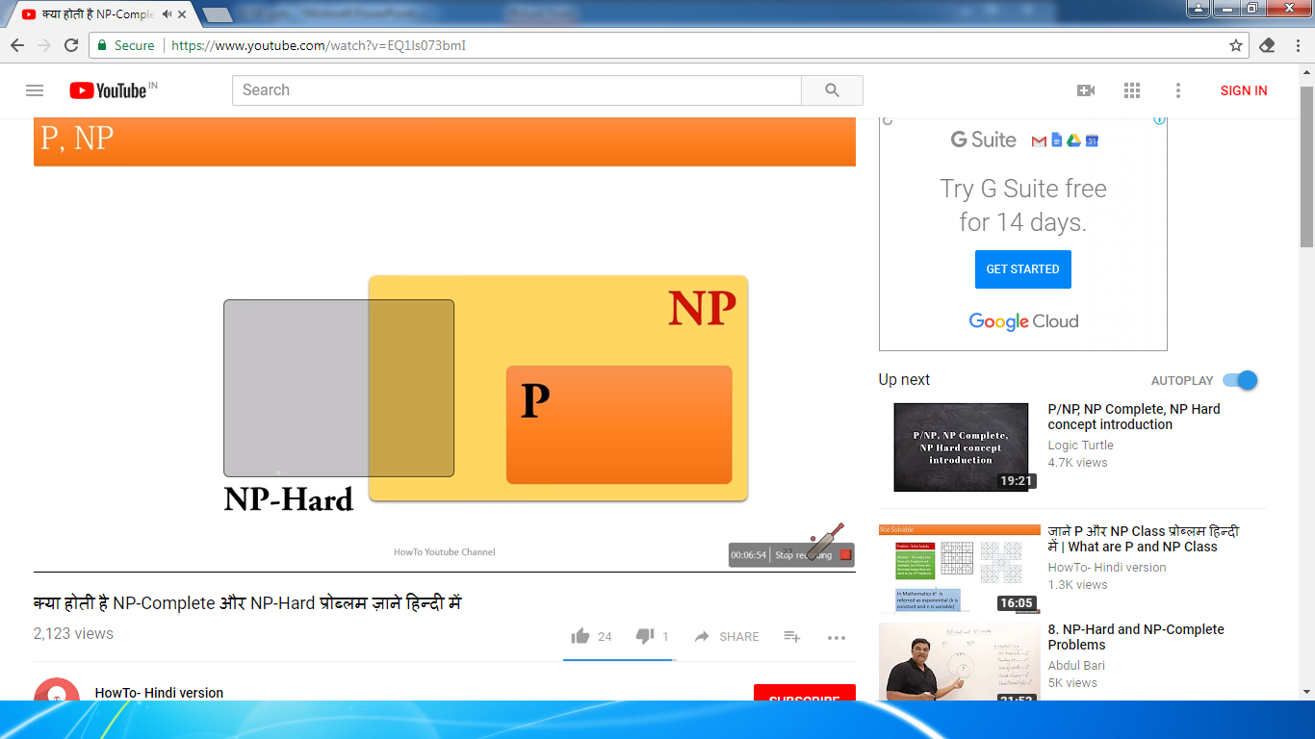
NP Complete

Slide 11
Understanding these concepts is crucial in algorithm design and analysis because NP-complete problems are generally considered intractable for large instances, and many real-world optimization problems are NP-hard.

Slide 12
Cook's theorem, also known as the Cook-Levin theorem, is a fundamental result in computational complexity theory. It was proved by Stephen Cook in 1971 and is considered one of the most important results in the field. Here's an explanation of Cook's theorem in simple terms:
Cook's theorem states that the Boolean satisfiability problem (SAT) is NP-complete. The Boolean satisfiability problem involves determining whether a given Boolean formula can be satisfied by assigning truth values (true or false) to its variables in a way that makes the whole formula true.
Here's what Cook's theorem means:
NP-Completeness: It shows that SAT is one of the hardest problems in the complexity class NP (nondeterministic polynomial time). This means that if you can efficiently solve SAT (in polynomial time), you can solve any problem in NP efficiently.
Reduction: Cook's theorem uses a concept called polynomial-time reduction. This means that any problem in NP can be transformed into an instance of SAT in polynomial time. So, if you can solve SAT efficiently, you can solve any problem in NP by first transforming it into an SAT instance and then solving that.
Consequence: Cook's theorem has far-reaching consequences because it established the concept of NP-completeness. If someone discovers a polynomial-time algorithm for solving any NP-complete problem, it would imply that P (polynomial time) equals NP (nondeterministic polynomial time), which is one of the most famous unsolved problems in computer science.
In essence, Cook's theorem provides a bridge between problems that are easy to verify (in NP) and those that are difficult to solve (NP-complete). It helps classify problems based on their computational complexity and has been instrumental in understanding the limits of efficient computation.

Slide 13
The Boolean satisfiability problem, often abbreviated as SAT, is a fundamental problem in computer science and mathematical logic. It involves determining whether a given Boolean formula can be satisfied by assigning truth values (true or false) to its variables in a way that makes the whole formula true.
Here's a bit more detail on the SAT problem:
Boolean Formulas: A Boolean formula is an expression built from variables, logical connectives (such as AND, OR, NOT), and parentheses. Variables can take on either a true (T) or false (F) value.
Satisfiability: The goal of the SAT problem is to determine if there exists an assignment of truth values to the variables in the formula such that the entire formula evaluates to true. If such an assignment exists, the formula is said to be satisfiable; otherwise, it is unsatisfiable.
Example: Consider the formula (A∨B)∧(¬B∨C)∧(¬A∨¬C)(A∨B)∧(¬B∨C)∧(¬A∨¬C). Here, A,B,A,B, and C.C are variables, ∨∨ represents OR, ∧∧ represents AND, and ¬¬ represents NOT. The question is whether there exists an assignment of true or false to A,B,A,B, and CC that makes the entire formula true.
Complexity: The SAT problem is known to be NP-complete, which means it is among the hardest problems in the complexity class NP (nondeterministic polynomial time). This implies that while it's easy to check if a given assignment satisfies the formula (in polynomial time), finding such an assignment can be computationally challenging for large instances of the problem.

Slide 14
The SAT problem has wide-ranging applications in computer science, including hardware and software verification, artificial intelligence, circuit design, cryptography, and more. It serves as a foundational problem in computational complexity theory and has led to the development of powerful algorithms and techniques for solving challenging computational problems.

Slide 15
Intractable problems are computational tasks that cannot be solved efficiently within a reasonable amount of time using current algorithms and computing resources. They often require exponential time or space to solve as their input size increases. Examples include the traveling salesman problem, where finding the shortest route visiting all cities is impractical for large numbers of cities

